Slide 1

Predicting the number of people injured in NYC

Slide 2
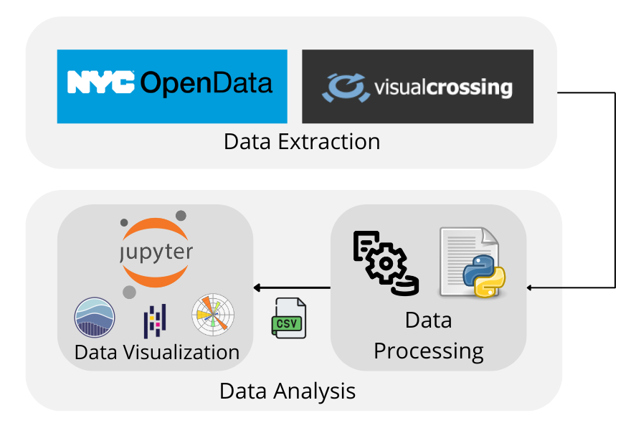
Project Plan

Slide 3
Data Integration
Schema Integration:
Global Scheme for NYC Weather, Traffic, and Accidents tables
We combined the datasets by using the date column as the common key across the weather, traffic, and accident tables.
01
Weather Table Attributes
Datetime
Tempmax , Temp min
Snow
Windspeed etc.
02
Accident Table Attributes
Crashdate
Zipcode
num_persons_killed
num_persons_injured etc
Date
traffic_id
hourly volumes(24 columns)(e.g hour_12am_1am, hour_1am_2am, hour_2am_3am….)
03
Traffic Table Attributes

Slide 4
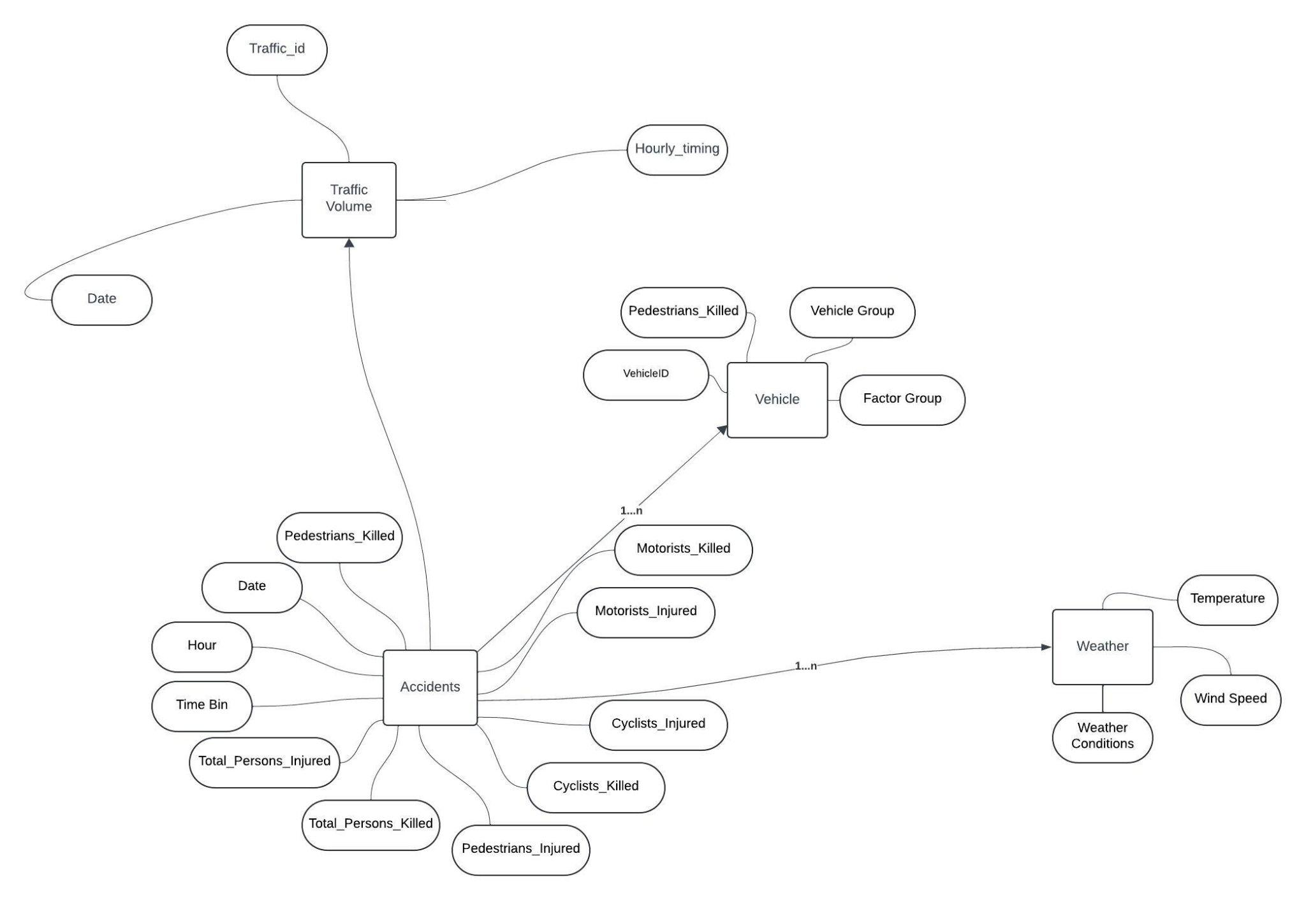
Entity Relation(ER):

Slide 5
Data Mapping
Mapping the date Column:
Source Tables: nyc_weather, traffic_volume, and nyc_accidents.
Mapped Attribute: date is used as the common key to link all tables. It ensures that data from different sources (weather, traffic, and accidents) corresponds to the same day.
Mapping Weather Attributes
Source Table: nyc_weather.
Mapped Attributes:
tempmin → minimum_temperature: Represents the lowest temperature recorded on a given day.
windspeed → average_wind_speed: Maps wind speed values to a unified attribute in the global schema.
snow → snowfall: Denotes the amount of snow recorded.
Mapping Accident Attributes
Source Table: nyc_accidents.
Mapped Attributes:
latitude and longitude → coordinates: Combines latitude and longitude into a single coordinates attribute for geospatial analysis.
zip_code → accident_area_code: Standardizes naming for ZIP codes related to accident locations.

Slide 6
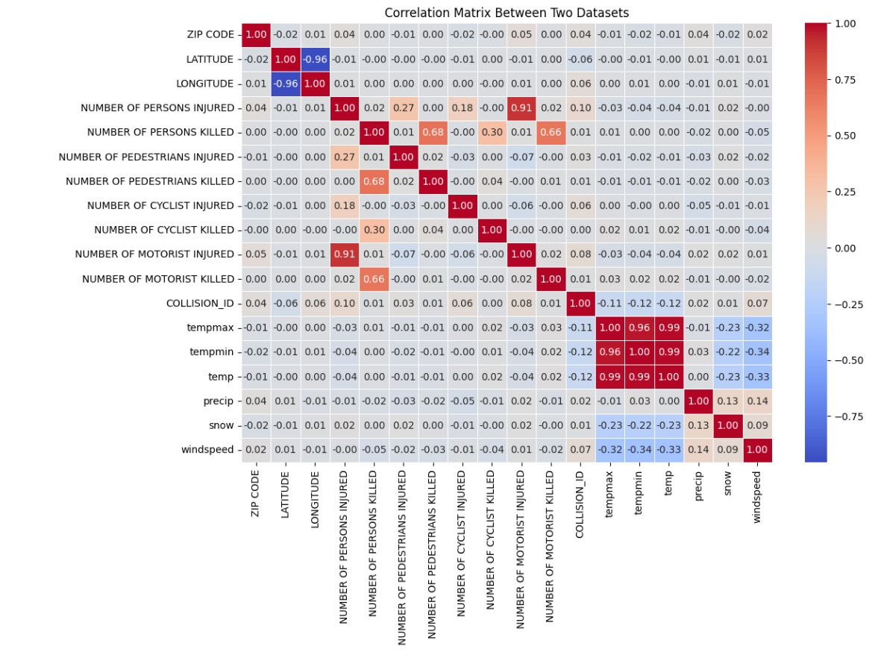
Correlation Matrix
High Correlation with Another Column: Highly correlated variables (e.g., tempmax, tempmin, temp) are redundant. Drop one (e.g., keep temp) to reduce dimensionality.
Low Correlation with All Other Variables: Columns with weak correlations (close to 0), like ZIP CODE, likely don't contribute and can be dropped.

Slide 7
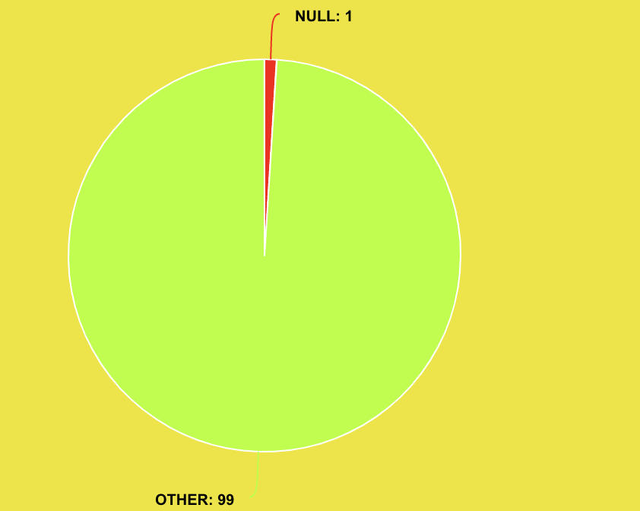
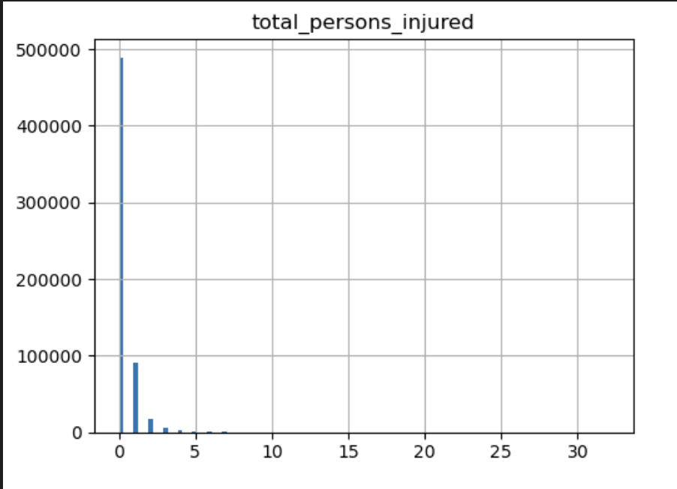
Data Cleaning
Null Handling:
Row Removal: Removed rows with missing values that represented only 1% of the dataset, ensuring minimal impact on overall analysis.
Imputation: For the temperature_avg column, missing values were imputed using averages from previous years to preserve temporal trends and continuity.
Outlier Detection:
Used histograms to get an idea of how the distribution is
Identified outliers using the Interquartile Range (IQR) method.
Decided that IQR was not ideal for this dataset due to its skewness.
Applied 99th percentile capping to limit extreme values while retaining data integrity.

Slide 8
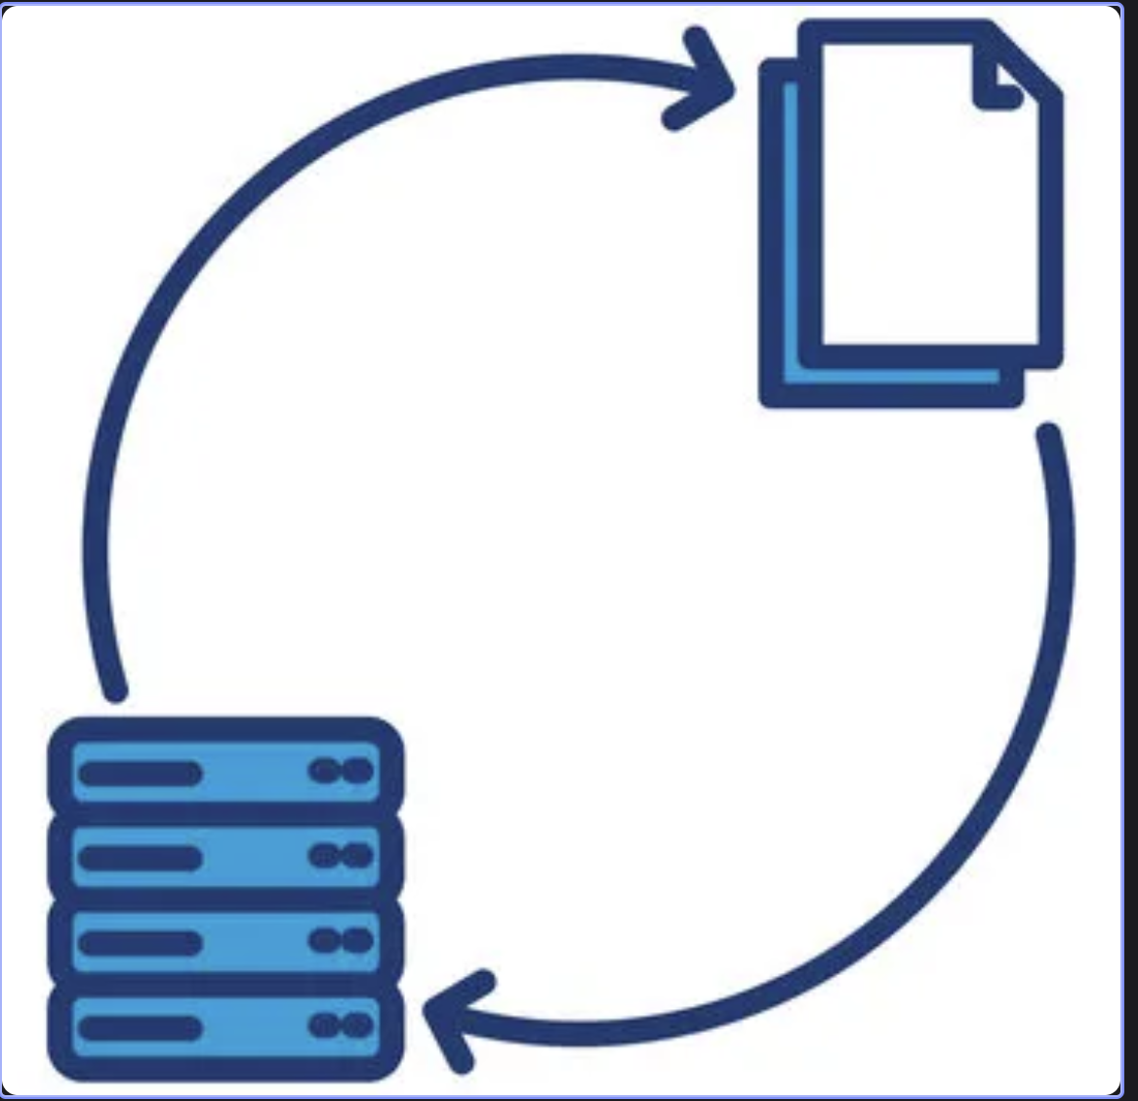
Data Transformation
Normalization:
Used Min-Max Scaling to scale numerical columns to a range of [0, 1].
Ensures all features have consistent scaling for downstream tasks.
Categorization:
Factor Group and Vehicle Group: Consolidated detailed categories into 5 broader, high-level categories for interpretability and dimensionality reduction.
Time of Day: Transformed time into categorical bins (e.g., "Morning," "Afternoon," "Night") for temporal analysis.
Different Scaling Functions:
Experimented with Z-Score Scaling, Max-Abs Scaling, and Robust Scaling to explore various approaches for handling numerical data.

Slide 9

Dashboard
Data Visualization
COMP333

Slide 10
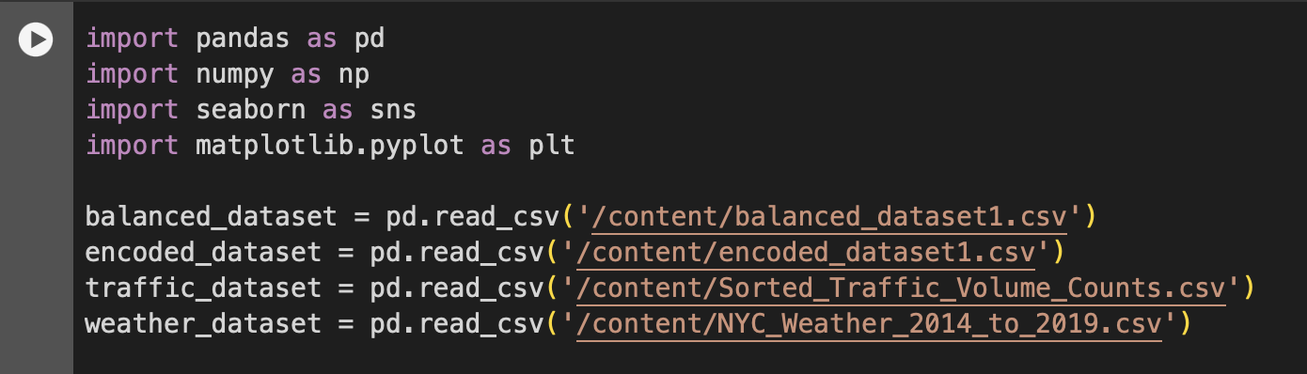
Tools

Slide 11
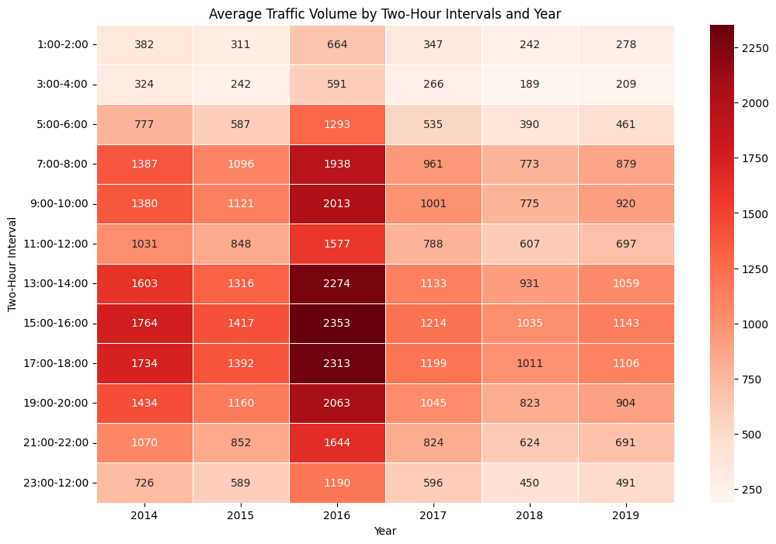
Heatmap

Slide 12
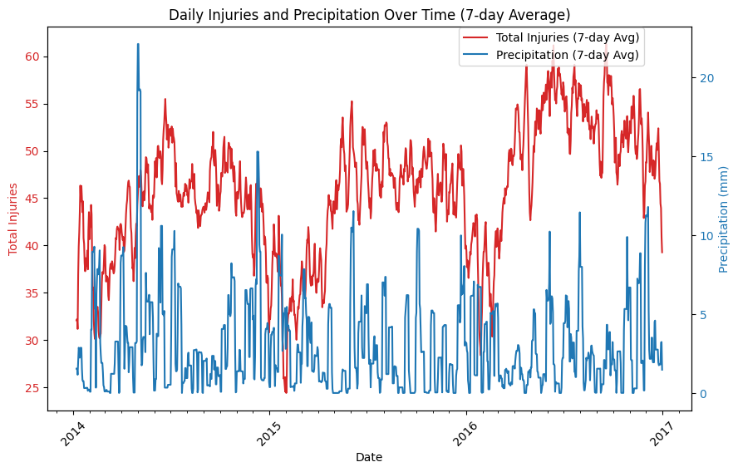
Time Series Analysis

Slide 13
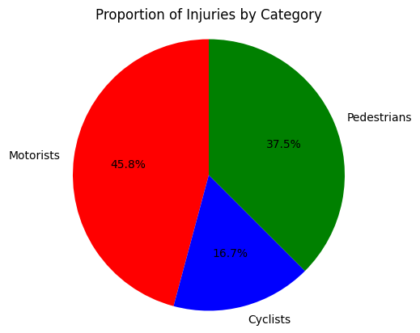
Pie-chart of injury categories

Slide 14
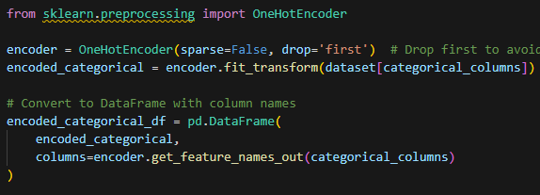
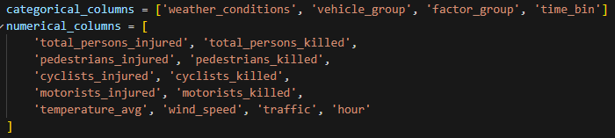
Data Encoding
Found columns with non-numerical values
Choose Right Categorical Feature Encoding Technique
Finding a Model to Train
One-hot encoding: Best for nominal variables with no inherent order. It creates binary columns for each category, making it suitable for most machine learning algorithms.
is a versatile technique suitable for most scenarios, especially with low-cardinality categorical variables.

Slide 15
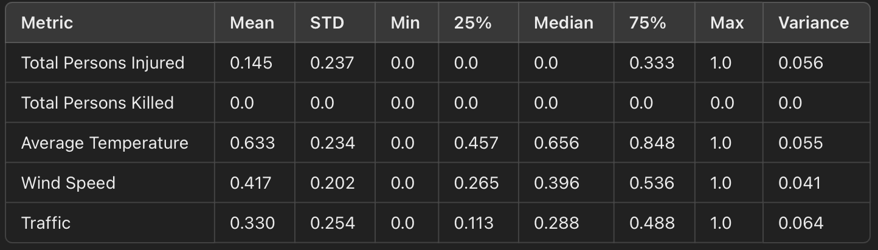
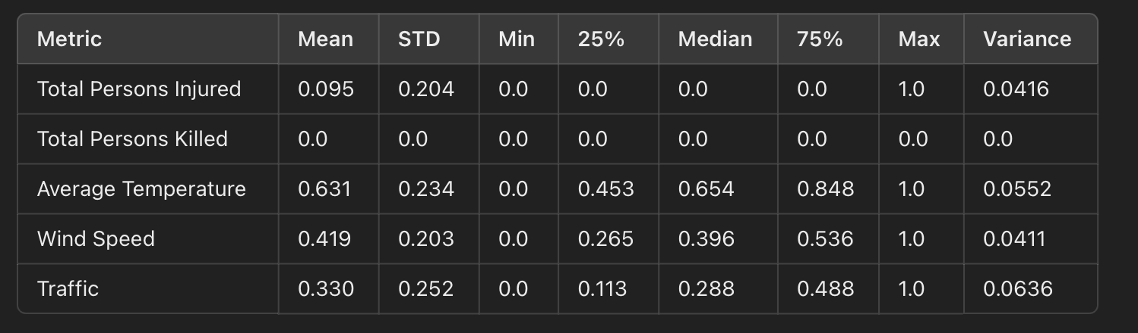
Balanced
Unbalanced

Slide 16
Training the Model
Machine Learning
Linear Regression
Random Forest Regressor
AutoML

Slide 17


Steps/Timeline
Linear Regression
Random forest regression
AutoML +
Balancing dataset
Next
Started by using Linear regression to obtain initial results to unders how would the model perform.
The initial results were:
Next I tried using different model to check if i would obtain similar results.
After reviewing the dataset, I found that the ratio of injured to non-injured is approx. 1:4.
The result in this case might be biased, so we changed the ratio to 1:2 by deleting records.
Then using AutoML to check if there are better models

Slide 18
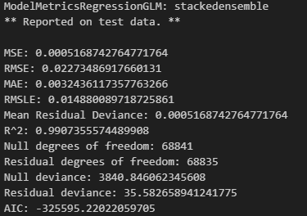
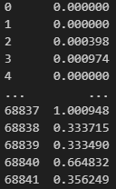
AutoML
Stackedensemble
H2O AutoML choose Stackedensemble as the most appropriate for our dataset and provided the following results:
Some prediction

Slide 19
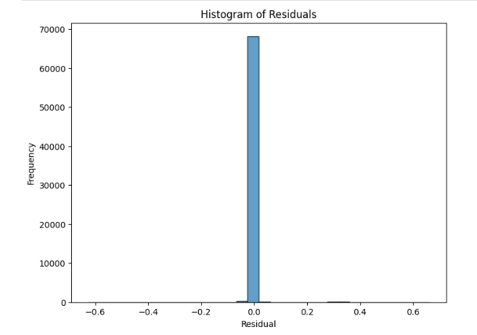
Visualizations
The residuals are highly concentrated around 0, with very few outliers.
A narrow peak around 0 suggests the model is highly accurate for most predictions.
Outliers (residuals far from 0) may indicate specific cases where the model struggled, possibly due to noise in the data or unmodeled complexity.
The residuals are tightly concentrated around 0, meaning predictions are accurate for most data points.

Slide 20
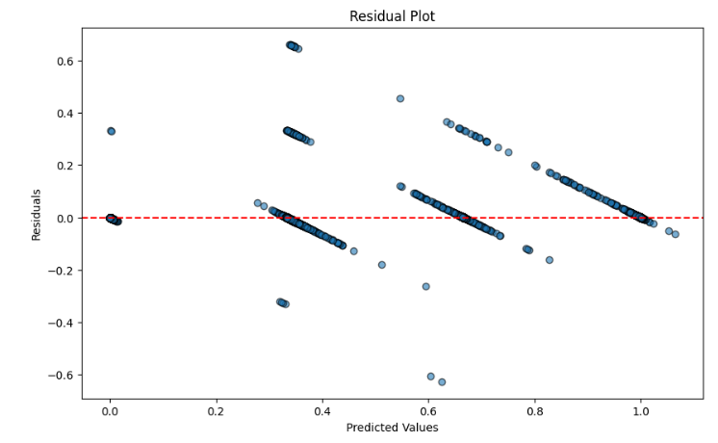
Visualizations
There is some clustering of residuals around specific predicted values.
Residuals are mostly centered around 0.
The clustering suggests the model predicts certain ranges (e.g., 0.4, 0.6, 1.0) more consistently
The model performs well overall but shows systematic clustering at certain ranges of predicted values.

Slide 21
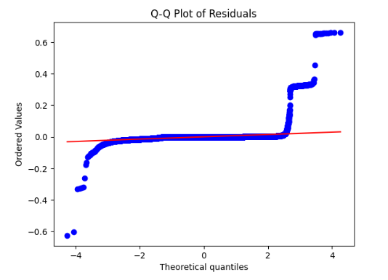
Visualizations
The points deviate from the red diagonal line, especially at the tails.
This suggests the residuals are not perfectly normally distributed, with some outliers or skewness.
The clustering suggests the model predicts certain ranges (e.g., 0.4, 0.6, 1.0) more consistently
Residuals deviate from normality, which may not be a major issue but suggests there could be some outliers or complexities not fully captured by the model.

Slide 22
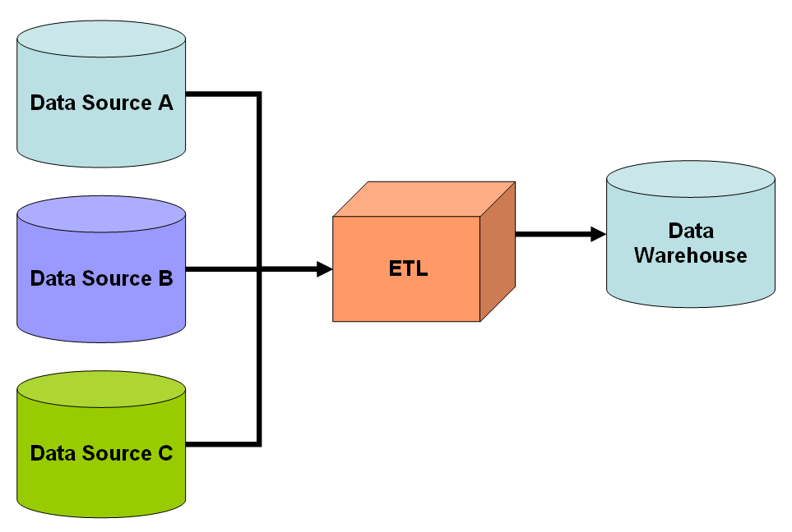
ETL(Extract-Transform-Load)
Extract:
(Data Sources)
NYC Weather: Extracted from visual crossing (CSV format).
Traffic Volume:Extracted from NYC Open Data (CSV format).
NYC Accidents: Extracted from NYC Open Data (CSV format).
Transform
Cleaning: Null Handling, Outlier Detection
Standardization:Used Min-Max Scaling to scale numerical columns
to a range of [0, 1].
Ensures all features have consistent scaling for downstream tasks.
Integration: We joined the datasets using date as the linking attribute
Load
(Target System)
The cleaned and transformed data were loaded into MySql Database
using MySQL Workbench tool
How did we import the data into the target system?

Slide 23
Thank you

